Slide 1

Amazon Web services

Slide 2
Agenda
AWS
About AWS
AWS Infrastructure
VPC
EC2
Instances
How to create an EC2 instance
S3
RDS
Lab: Hosting a Static Website using AWS S3

Slide 3
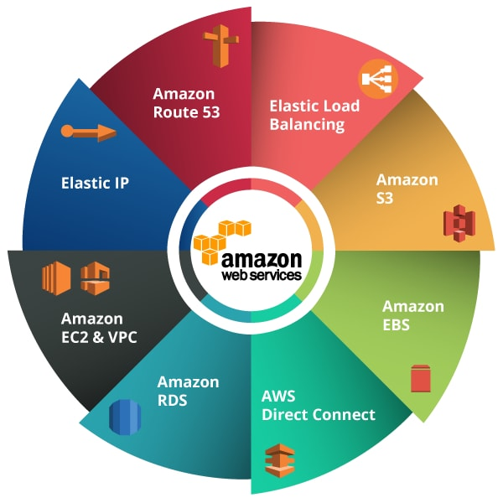
AWS
World’s most comprehensive and broadly adopted cloud
200+ services provided
Billing is “pay-as-you-go”
Around 1 GB/s network speed
Among the most pouplar services: EC2, S3, Beanstalk, Route 53, RDS, etc.

Slide 4
AWS Network Infrastructure
31 geographic regions around the world
Regions are basically clusters of data centers
There are Availability Zones within regions, which means each Availability Zone is a of logical data centers
For instance, in the Middle East we have 2 regions, in Bahrain and UAE
In Bahrain we have 3 Availability Zones
“All AZs in an AWS Region are interconnected with high-bandwidth, low-latency networking, over fully redundant, dedicated metro fiber providing high-throughput, low-latency networking between Azs”
Not all AWS services are available in all regions

Slide 5
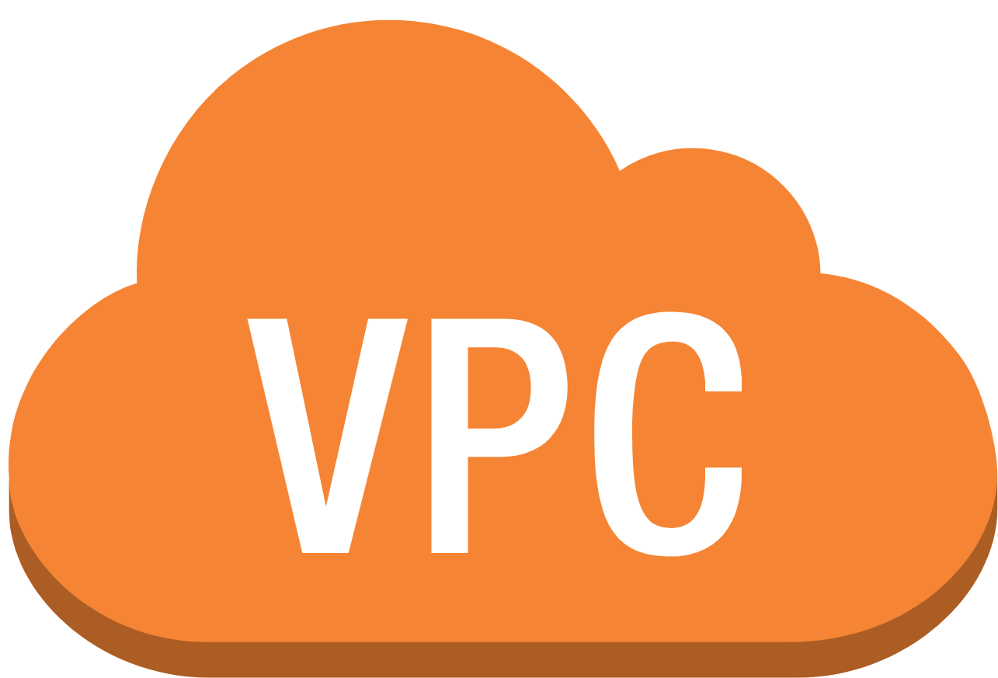
VPC
Upon sign up, AWS creates for you a VPC, a Virtual Private Cloud
Allows you to isolate and host your resources from other things on the cloud
Within your VPC, you have logically separated subnets
You have a gateway at your VPC to allow you to interface with the internet

Slide 6
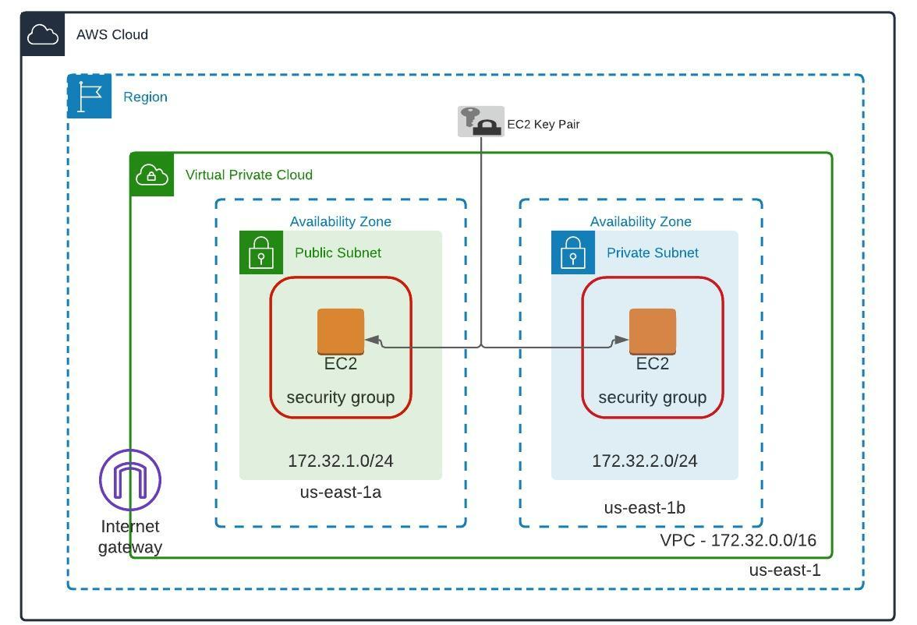
VPC

Slide 7
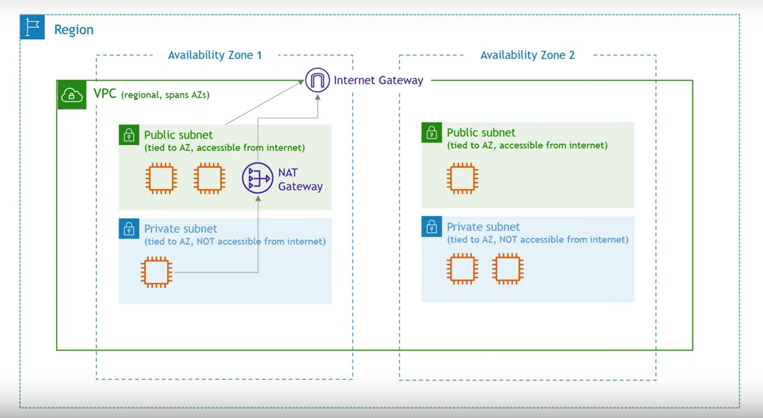

Slide 8
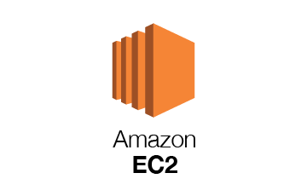
EC2
Stands for Elastic Compute Cloud
provides scalable computing capacity, so no need to invest in physical hardware servers
Basically used to launch a virtual server using virtual computing environments, known as instances

Slide 9
What is an Instance?
EC2 instance is a virtual server in Amazon's Elastic Compute Cloud
You can use different configurations of CPU, memory, storage and networking resources in these instances
Created using AMI – Amazon Machine Images
They are units of deployment, a template containing software configurations, including the operating system

Slide 10
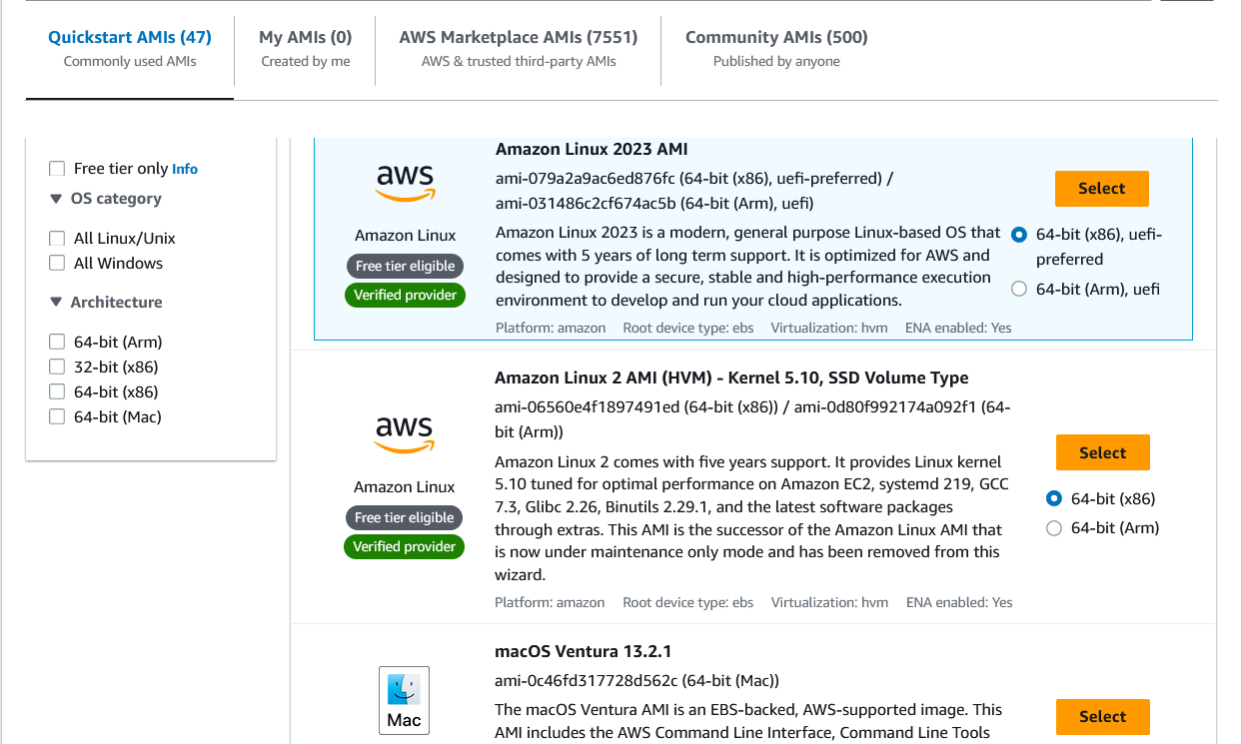
Example of AMIs
Different OS’s, architectures, etc.

Slide 11
Steps for creating an Instance
Choose a region to launch your instance
Choose AMI
Choose Instance type
Configure network settings and security
Add Storage
Select Key Pair & Download
Launch Instance
Connect to your Instance

Slide 12
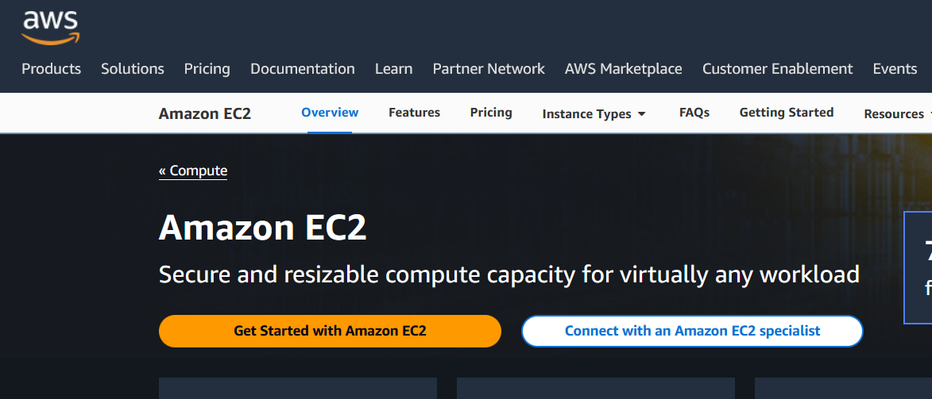
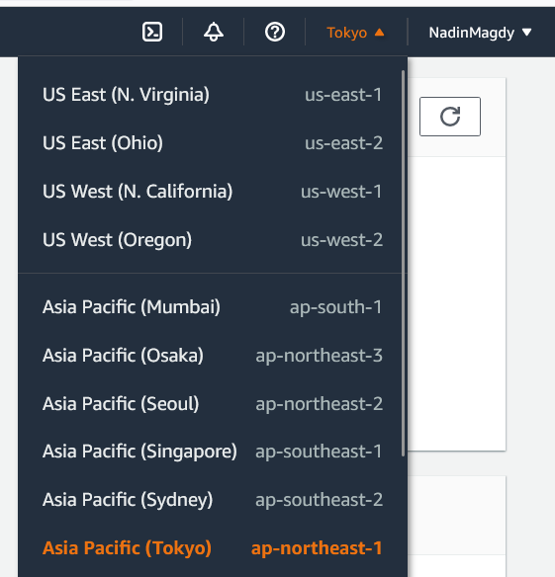
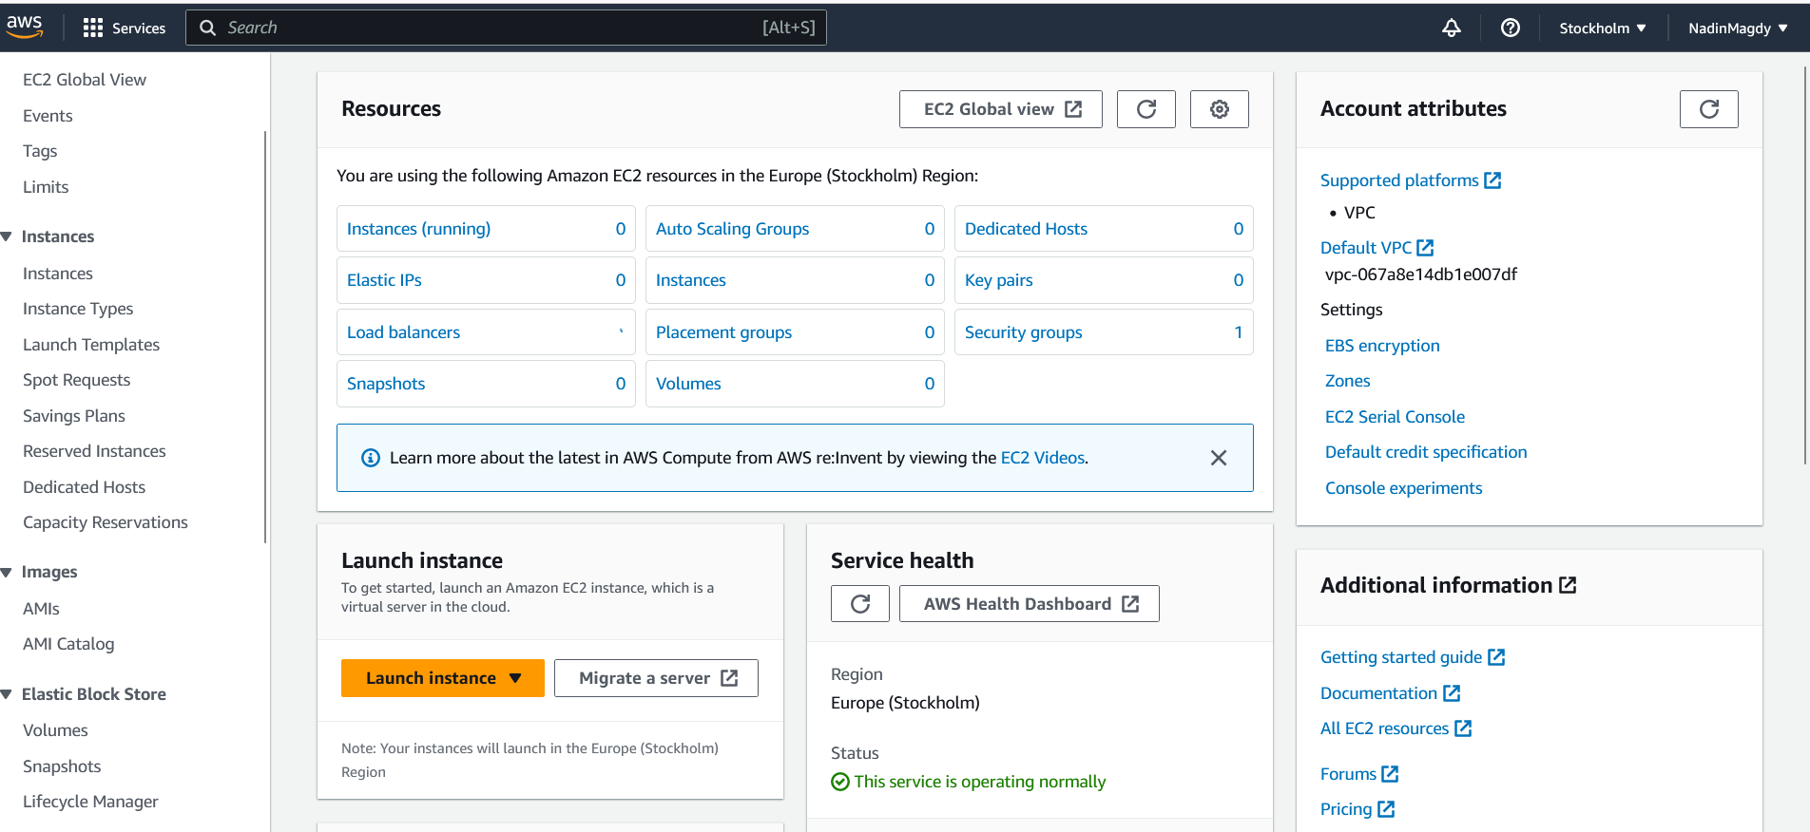
#1 Choose Region and Launch
Note: you might be charged $1 for the first time using the credit card you signed up with (when you terminate your instance)

Slide 13
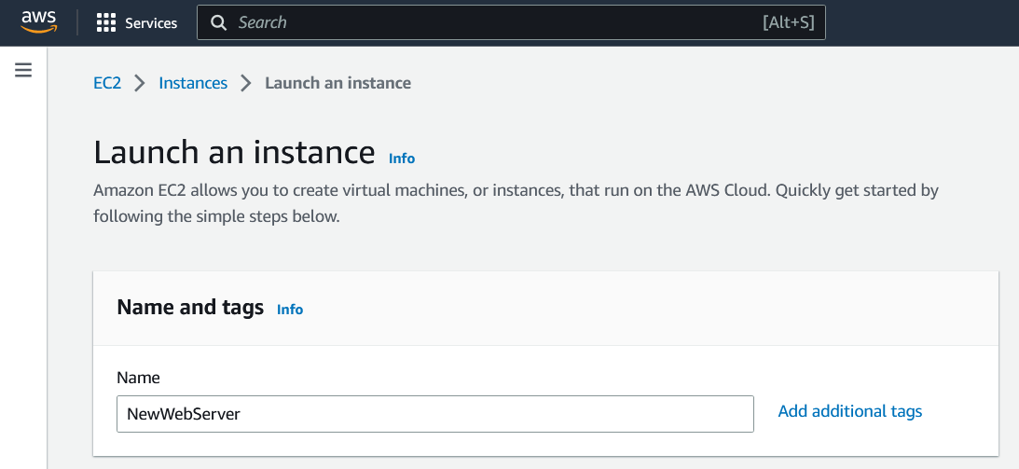

Slide 14
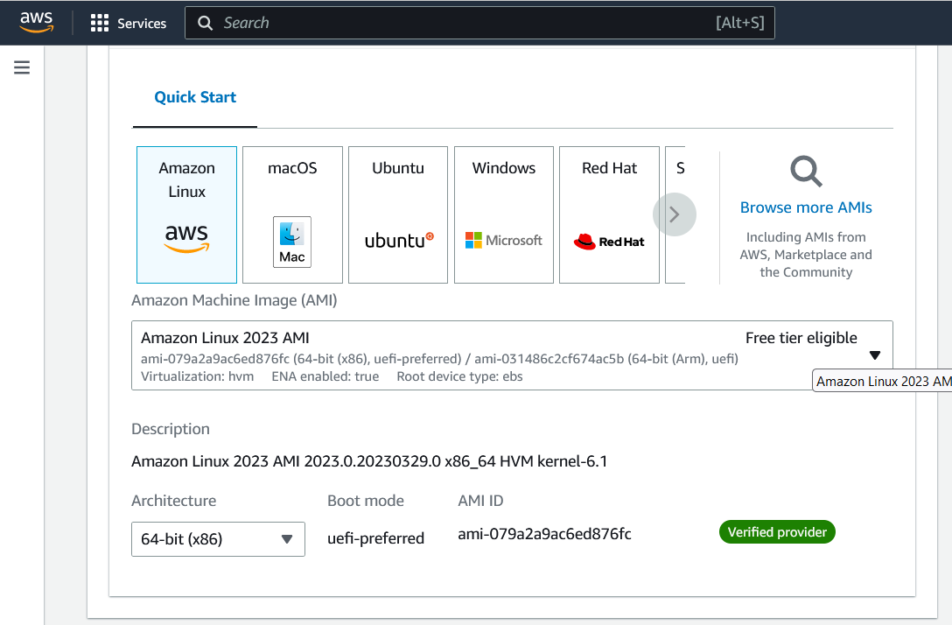
#2 Choose AMI

Slide 15
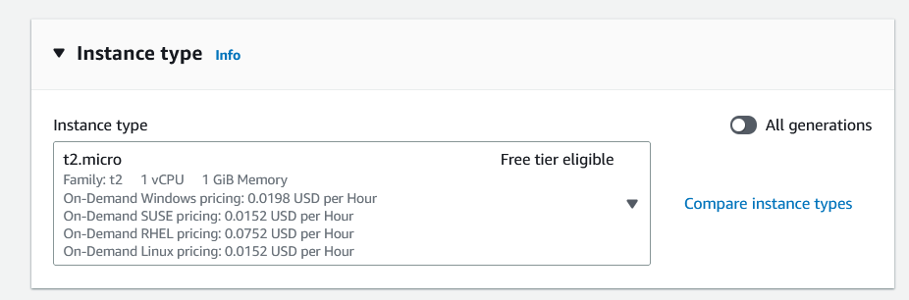
#3 Choose Instance Type

Slide 16
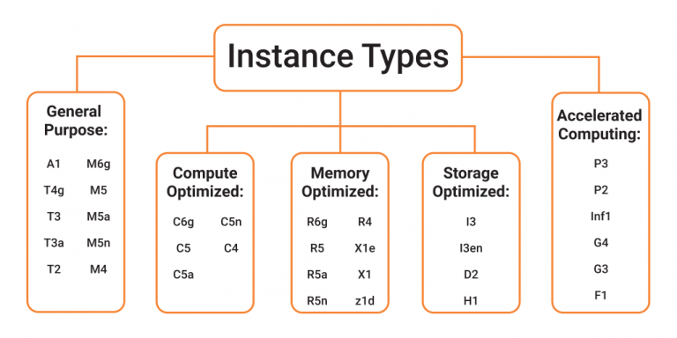
#3 Choose Instance Type – Contd.
Different combinations of CPU numbers, memory, storage are made for different purposes
Can be general purpose or made for something specific, e.g. for high computing power, will have mor CPU

Slide 17
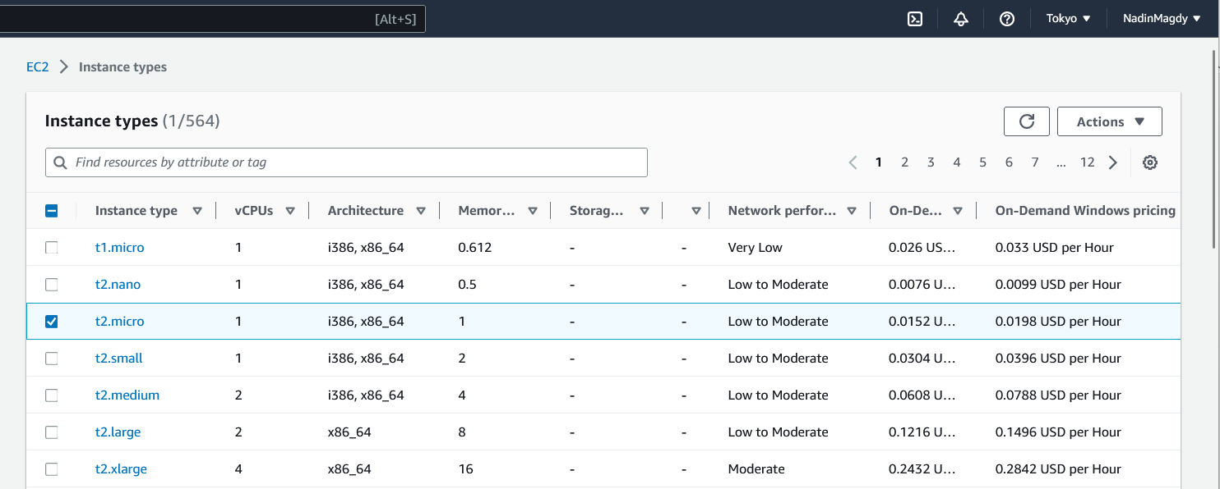
#3 Choose Instance Type – Contd.

Slide 18
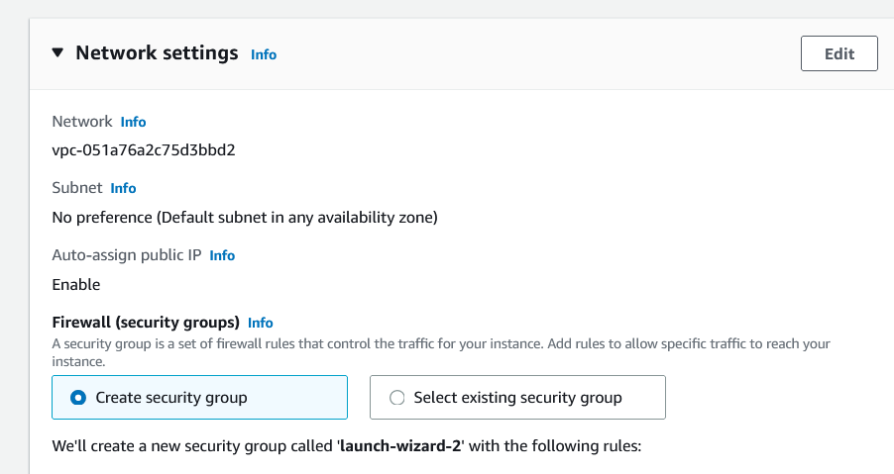
#4 Configure Network Settings & Security
VPC is created for your instance – Virtual Private Cloud

Slide 19
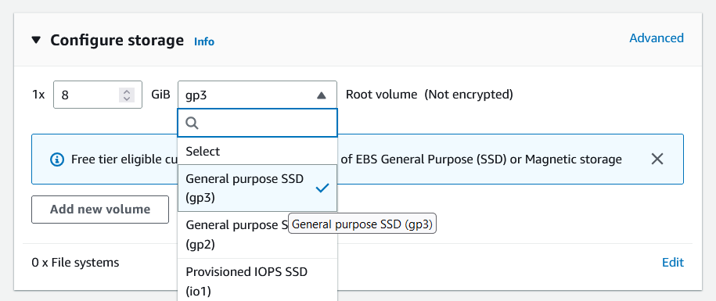
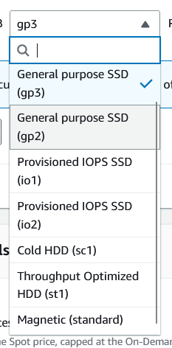
#5 Configure Storage
The more storage you will use, the more money it will cost
You mainly choose between SSD and Magnetic Storage (like hard disk drive)

Slide 20
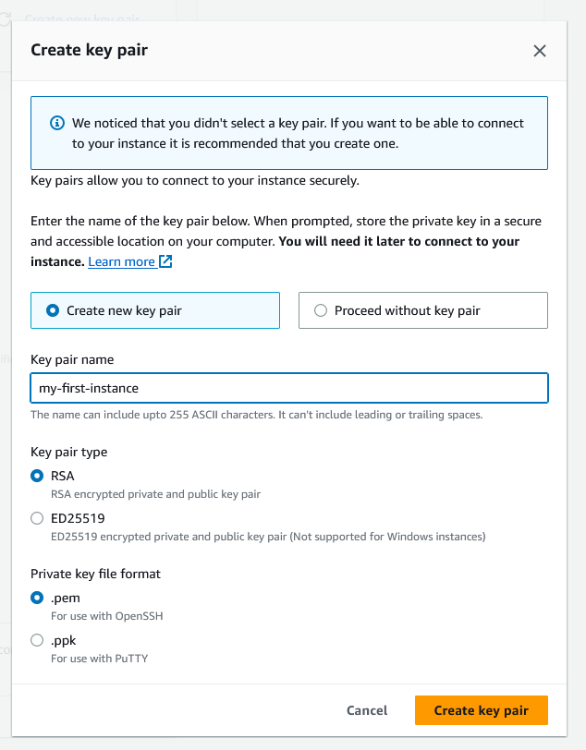
#6 Create Key Pair and Download
This key pair is like a password to be able to connect to your instance, once you create the pair you will download .pem file - Privacy Enhanced Mail Certificate file

Slide 21
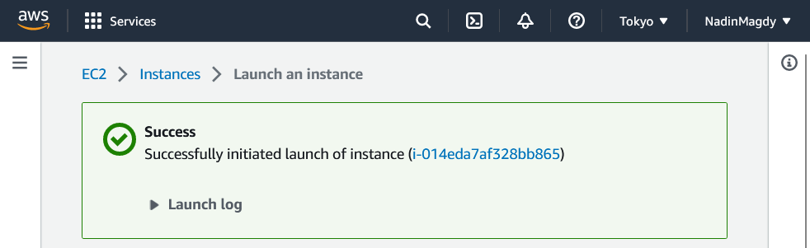
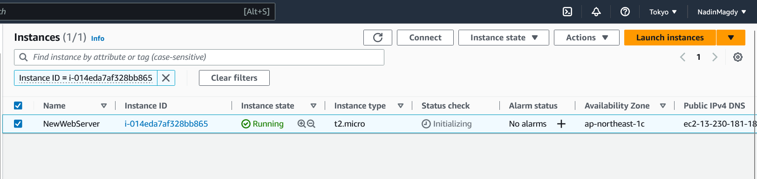
#7 Launch Instance

Slide 22
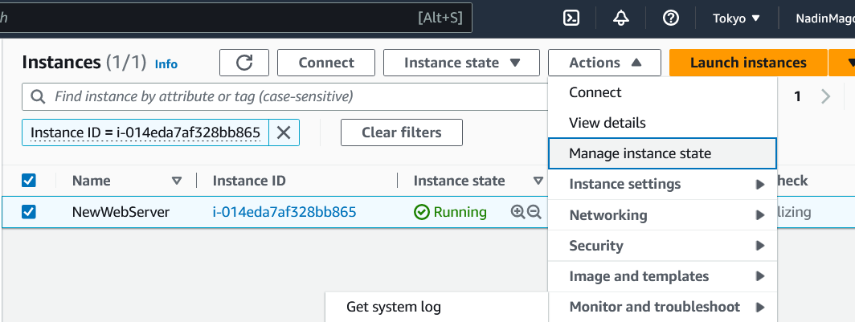
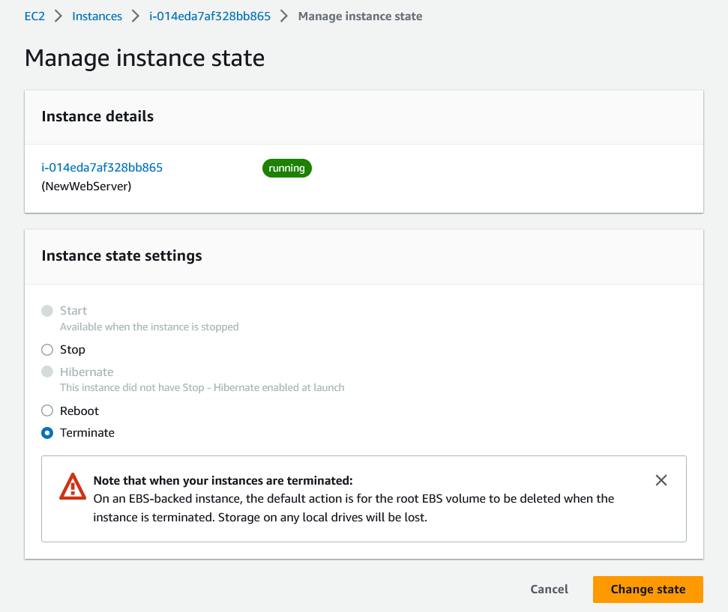
Terminate Instance to Avoid billing afterwards

Slide 23
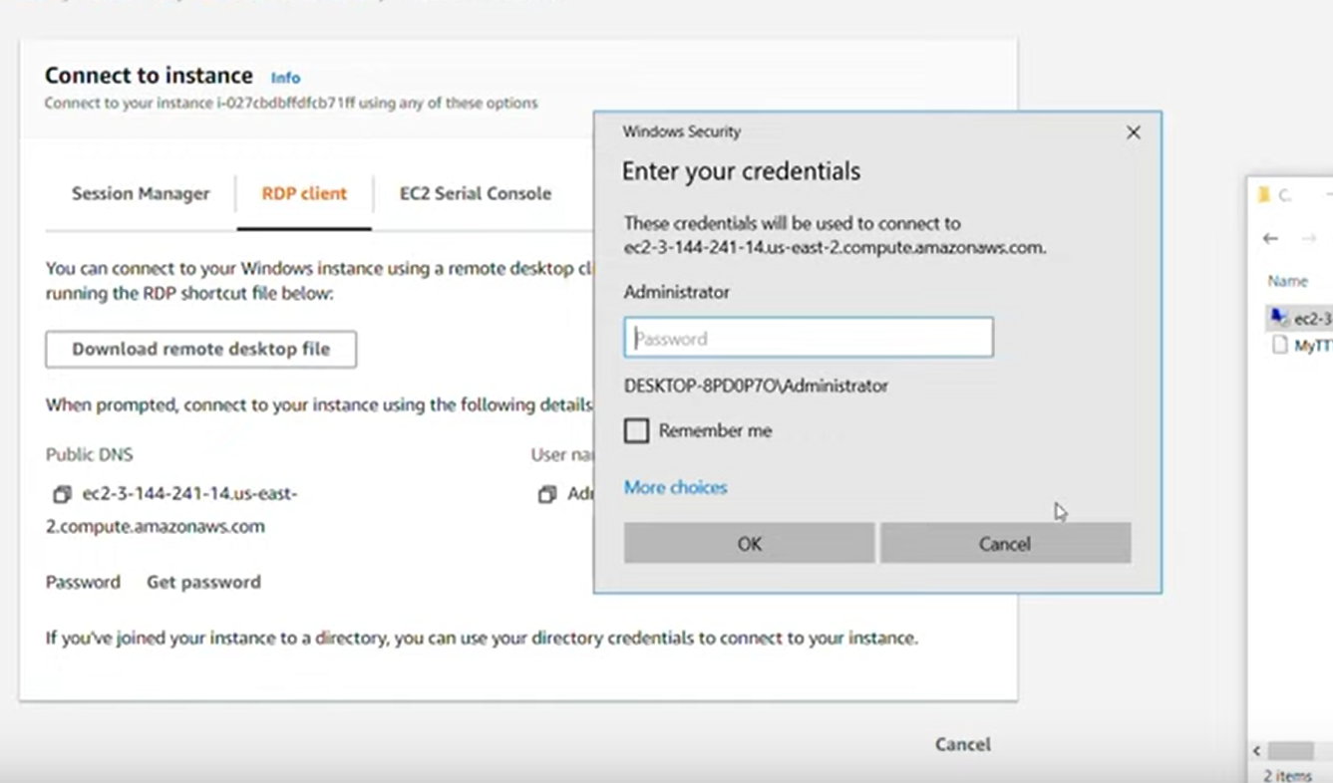
#8 Connect Instance

Slide 24

S3
Stands for Simple Storage Service
Type of SaaS provided by AWS
Easy to scale, accessible anywhere
Object-based storage, so you can store videos, images, files, etc.
Files stored in what is called Buckets
Entities stored in Buckets are referred to as Objects
Objects stored in a region are not transferred to other regions unless you explicitly make them

Slide 25
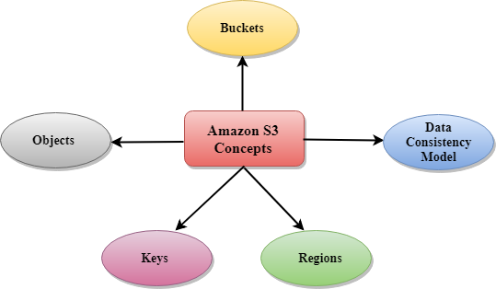
S3 Concepts
Objects are entities that you actually store in the server, e.g. .html files
Each object has a Key
A combination of bucket name, the key, etc. are used to create the endpoint link e.g. http://bucketname.s3.amazonaws.com/key/Amazons3.wsdl
Region is chosen in such a way that it optimizes the latency, minimize costs or address regulatory requirements
Uses the Eventually Consistent System as its data consistency model

Slide 26

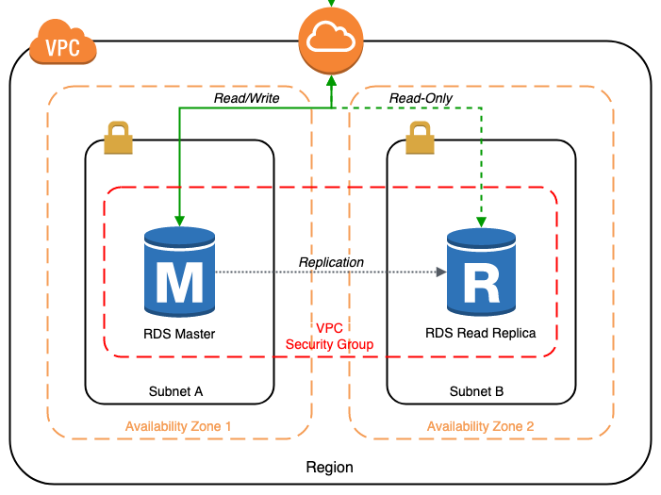
RDS
Stands for Relational Database Service
Manages databases in the AWS cloud
Supports PostgreSQL, MySQL, Maria DB, Oracle, SQL Server, and Amazon Aurora
RDS instances use Amazon Block Storage (EBS) volumes for storing data and log, these storage types can dynamically increase their size as and when needed

Slide 27
Lab: Host a Static Website using AWS S3
Go to S3 page in AWS
Create a bucket
Enable static website hosting
Place the name of the .html file in the Index Document page
Open end-point link – you will find it does not open as it is private by default, so edit public access setting of bucket
Edit bucket policy by adding the .json text in the next slide
Upload any .html document to the Objects in the S3 bucket
Your static website is up and running!

Slide 28
Lab: Host a Static Website using AWS S3

Slide 29
References
https://www.tutorialspoint.com/amazon_web_services/amazon_web_services_tutorial.pdf
https://www.techtarget.com/searchaws/definition/Amazon-Web-Services
https://www.techtarget.com/searchaws/definition/Amazon-EC2-instances
https://www.javatpoint.com/aws-s3-concepts
https://www.youtube.com/watch?v=7_NNlnH7sAg
https://www.tutorialspoint.com/amazonrds/amazonrds_db_storages.htm

